Slide 1
M. Emre POYRAZ
Job Application for Junior Insight Analyst

Slide 2

This is my application for the position of «junior data analyst» at /Data.
Let me tell you about:
Who I am,
Why I believe I would make a good candidate.
(Playing in the background is «Analyze» by Thom Yorke. I thought that would be fitting!)

Slide 3
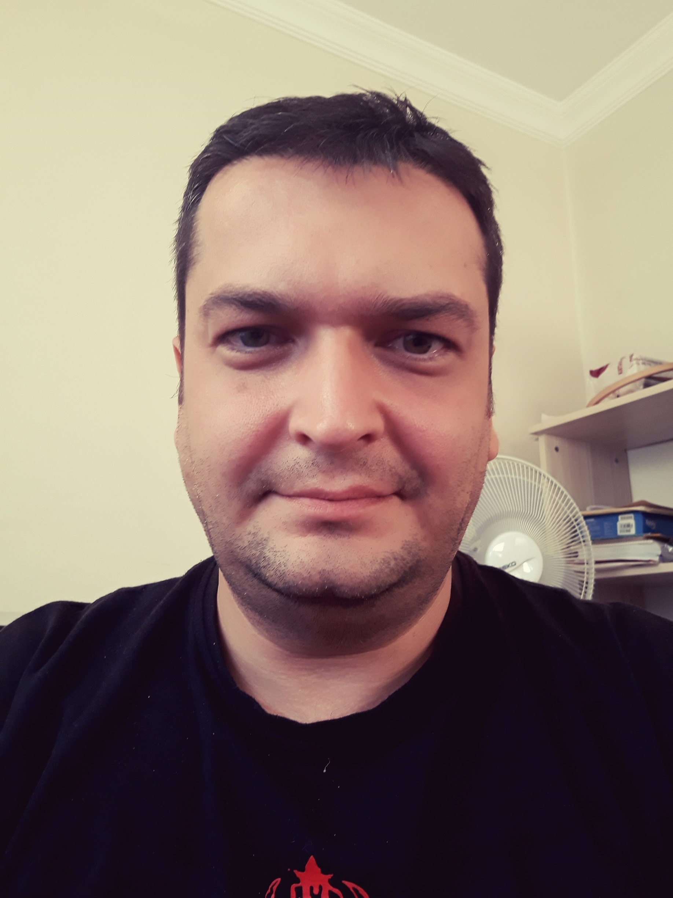
So, this is me!

Slide 4
I have a degree in Economics (graduated in 2001)
I am working for the Ministry of Transport and Infrastructure in Ankara, Turkey.
What do I there? I work with international projects (especially EU projects) related to the transport sector. The biggest + is being in a very international environment (because we always have teams of experts from all European countries coming and going). The biggest – is, having the same job for 15 years.

Slide 5
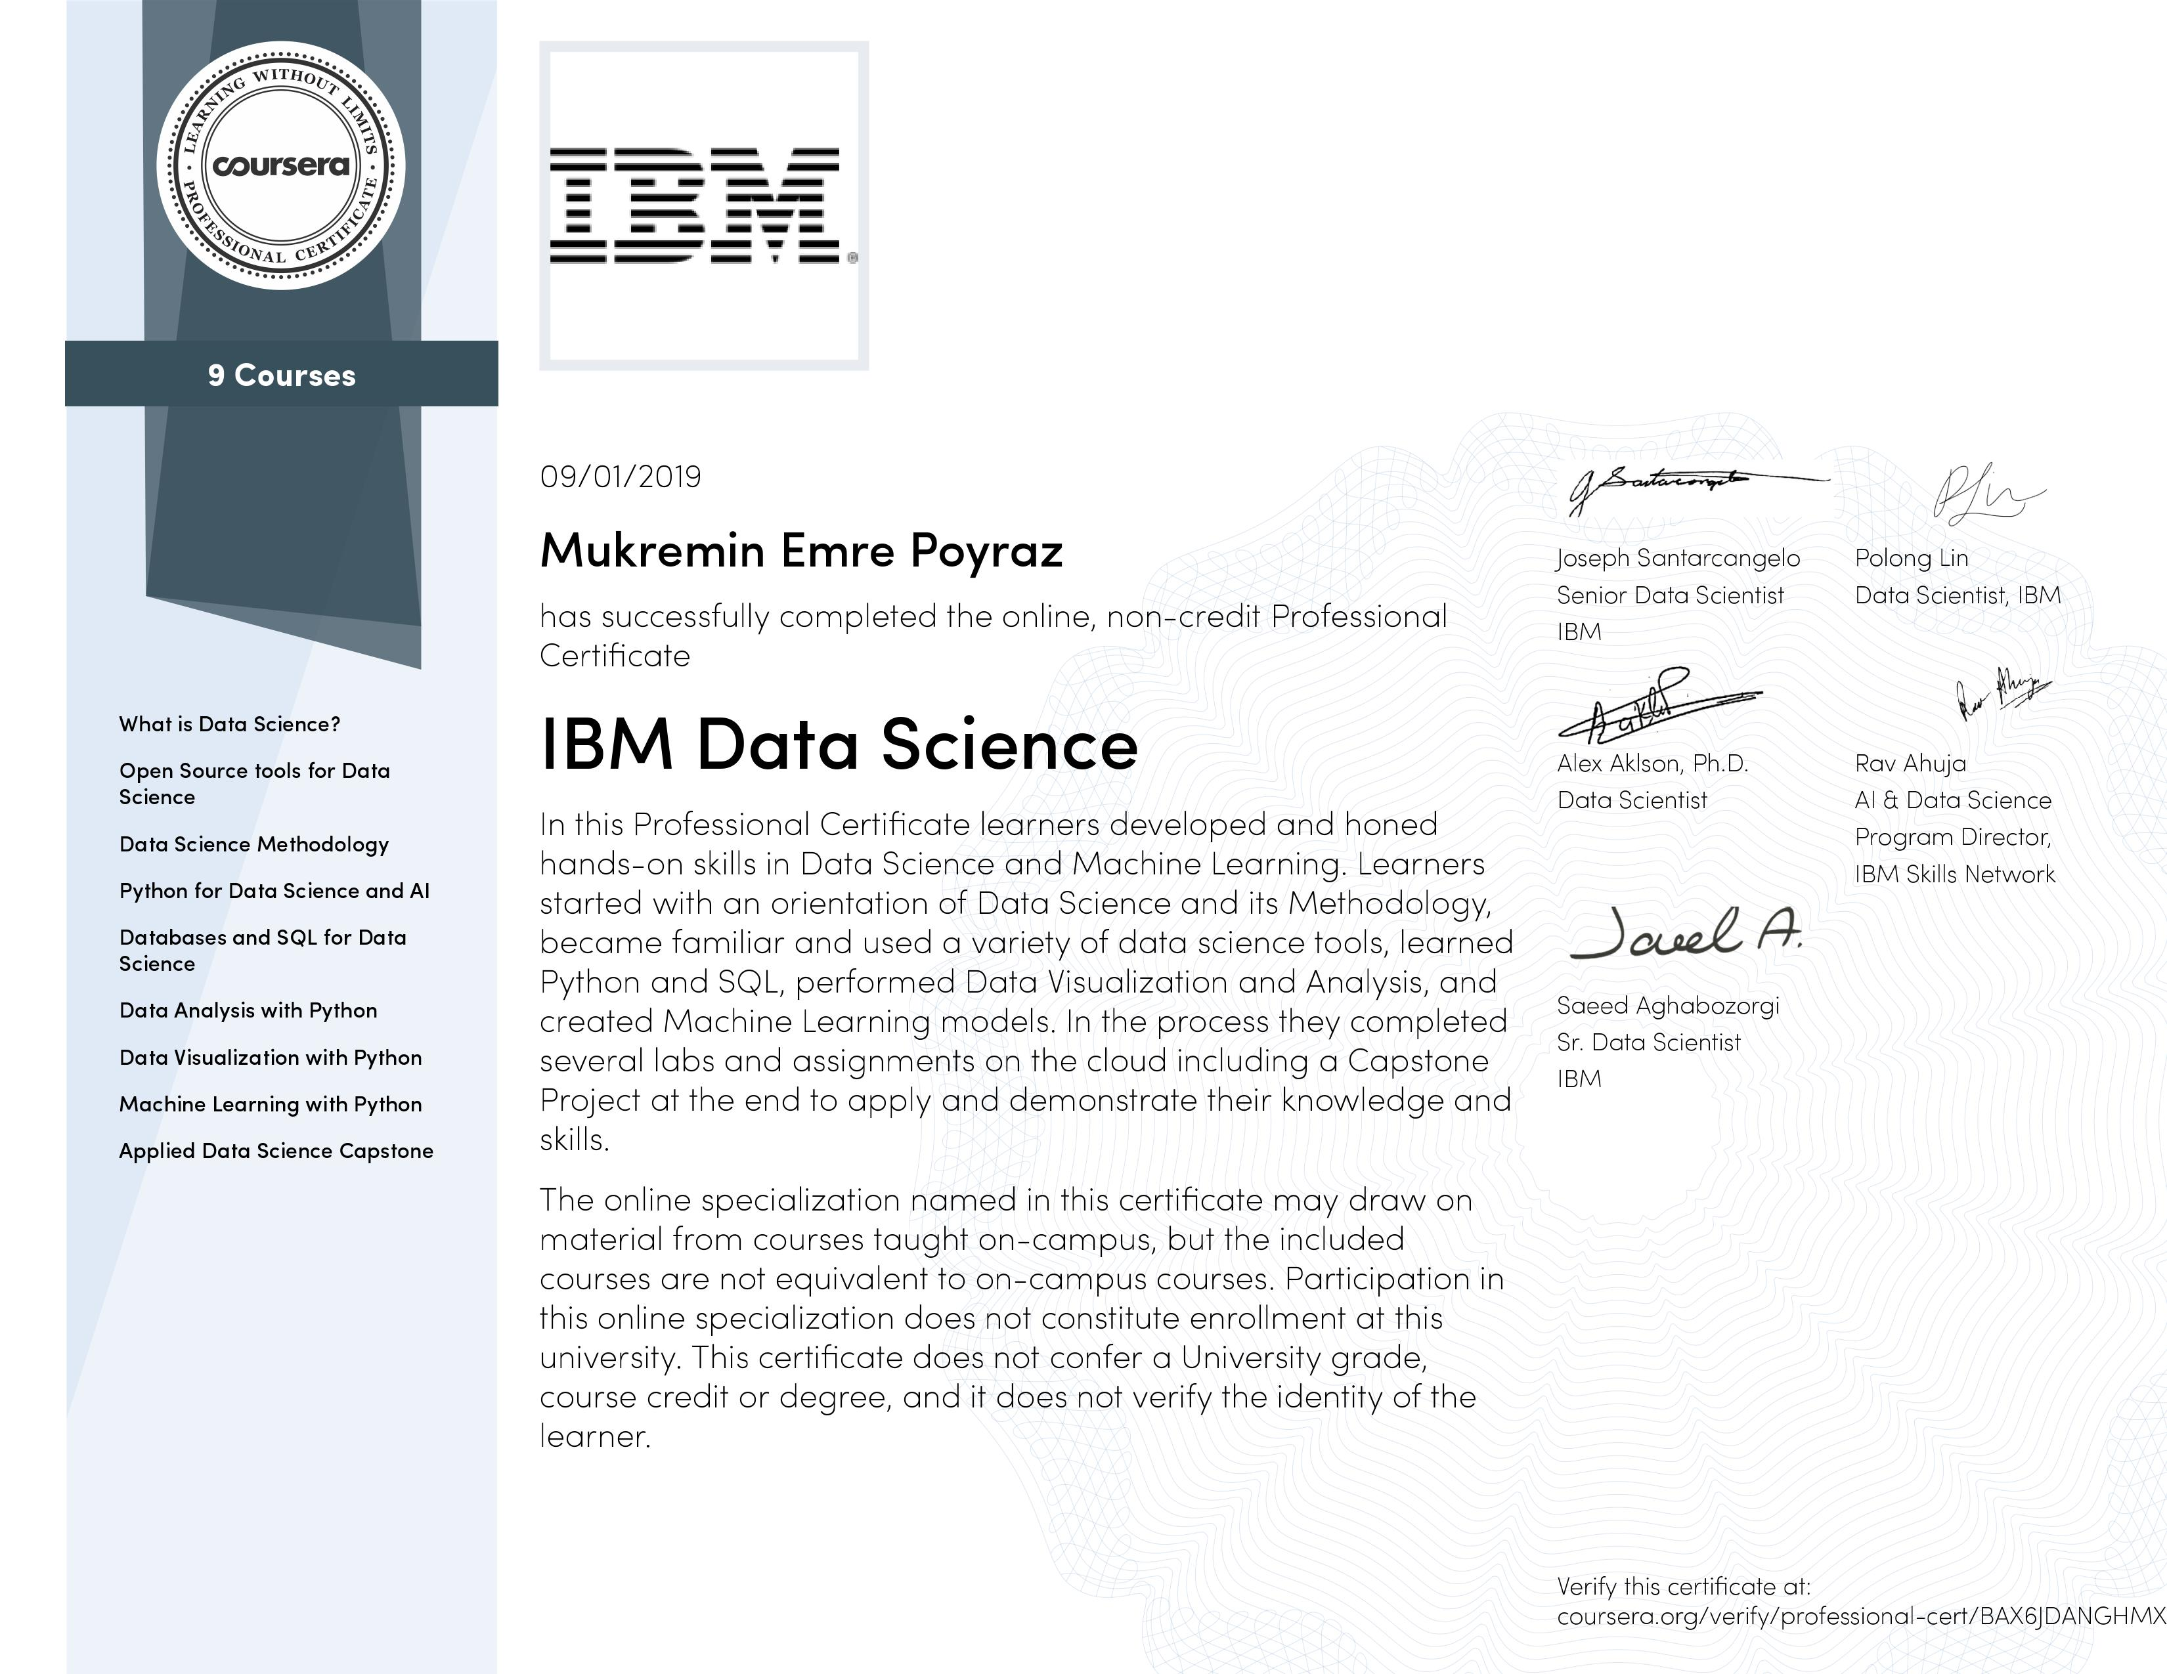
So, in 2018 I decided to switch careers and for more than one reason, I decided to move to data analytics.
I began by self studying but after a time, I started taking online classes (mostly on Coursera).
And I’m quite proud of this one.
https://www.coursera.org/professional-certificates/ibm-data-science

Slide 6

And currently I’m studying for this one:

Slide 7
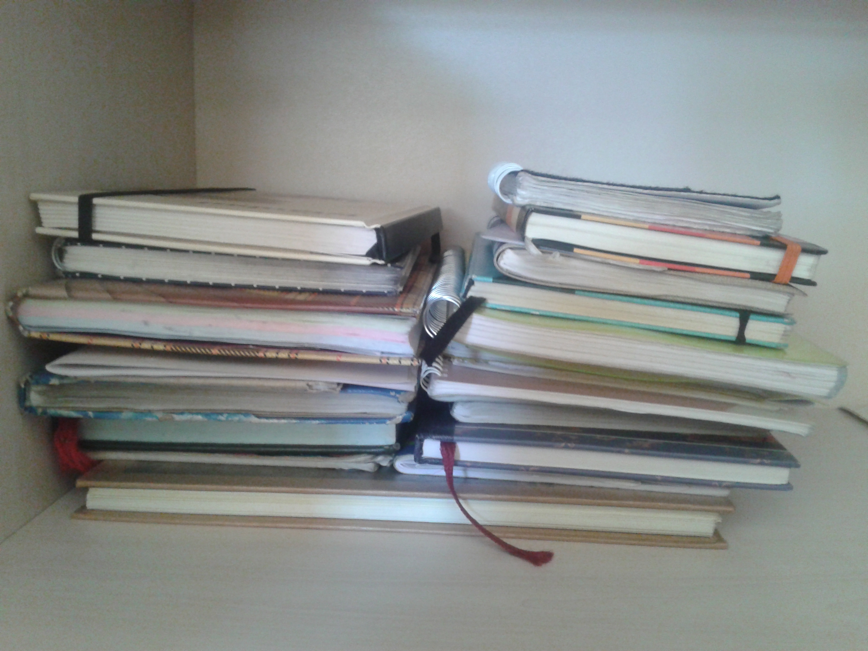
I am also a good reader of history, philosophy, political science and psychology (I really enjoy having the «social sciences» mindset.)
I hugely love writing! (This is a photograph of some of my journals. It’s all handwritten.)

Slide 8
What about the position and me? Is this a match made in Heaven?
As I understand, this position requires someone who will:
Follow up the developments in data science (not only the technology but also economics, people, trends, etc)
Again, use data science tools and methodology to analyze these
And, follow up with some sort of reporting.

Slide 9
While I dont have «professional» experience in data science, I had my share of hands-on training. You can see some here:
https://github.com/emre-poyraz/coursera-capstone-ibm
Economics is both a social and qualitative discipline, and I believe I can bring a unique perspective to the table.
Excel: I have been using if for around 20 years!
My English skills can be judged by this presentation.

Slide 10
Some less important stuff:
The UK and Ankara has about 2 hrs time difference. I can be available.
I have a Green Passport, that means I am able to travel without restrictions to EU countries (but not to the UK, sorry!)
My full cv is here:
https://www.linkedin.com/in/m-emre-poyraz-b64a8912a/
I’ll be looking forward to hearing from you. Goodbye!
00 90 535 966 46 57
emre_poyraz@hotmail.com

